Slide 1
Lecture 14
Requirements Modeling:
  Context Model
BSSE (Software Engineering-I) SZABIST-Islamabad

Slide 2
Context Model
Interaction Model | Structural Model
•Modeling user interaction is important as it helps to identify user requirements. •Modeling system-to-system interaction highlights the communication problems that may arise. •Modeling component interaction helps us understand if a proposed system structure is likely to deliver the required system performance and dependability. •Use case diagrams and sequence diagrams may be used for interaction modeling. Example: Usecase, Activity, Swimlane | •Structural models of software display the organization of a system in terms of the components that make up that system and their relationships. •Structural models may be static models, which show the structure of the system design, or dynamic models, which show the organization of the system when it is executing. •You create structural models of a system when you are discussing and designing the system architecture. Example: Class Diagram
Behavior Model | Context Model
•Behavioral models are models of the dynamic behavior of a system as it is executing. They show what happens or what is supposed to happen when a system responds to a stimulus from its environment. •You can think of these stimuli as being of two types: –Data Some data arrives that has to be processed by the system. –Events Some event happens that triggers system processing. Events may have associated data, although this is not always the case. Example: State Diagram, Sequence Diagram | •Context models are used to illustrate the operational context of a system - they show what lies outside the system boundaries. •Social and organizational concerns may affect the decision on where to position system boundaries. •Architectural models show the system and its relationship with other systems. Example: Data Flow Diagram

Slide 3
Context Model
  Context models are used to illustrate the operational context of a system - they show what lies outside the system boundaries.
  Social and organizational concerns may affect the decision on where to position system boundaries.
  Architectural models show the system and its relationship with other systems.
  Example: Data Flow Diagram

Slide 4
Data Flow Diagram
A data flow diagram (DFD) is a graphical representation of the movement of data between external entities, processes and data stores within a system.

Slide 5
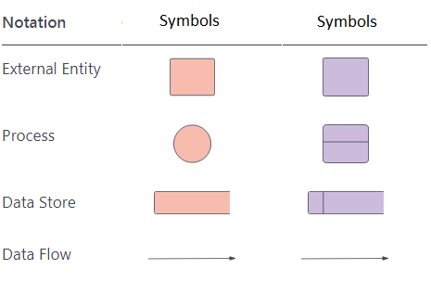
Data Flow Diagram Symbols
External entities (sources and sinks)
Data Stores
Data Flows
Processes

Slide 6
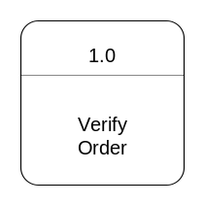



External Entities aka Source/Sink
An outside system that sends or receives data, communicating with the system being diagrammed.
They are the sources and destinations of information entering or leaving the system.
They might be an outside organization or person, a computer system or a business system.
They are also known as terminators, sources and sinks or actors. They are typically drawn on the edges of the diagram.
External
Entities

Slide 7
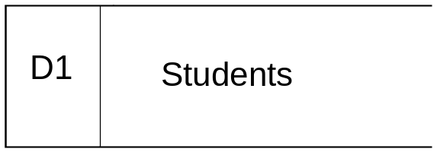
Data Stores
Files or repositories that hold information for later use, such as a database table or a membership form.
Data at rest!
Labels should be noun phrases
Internal to the system
Include in system if the system processes transform the data
  Store, Add, Delete, Update
D1
Data Stores

Slide 8
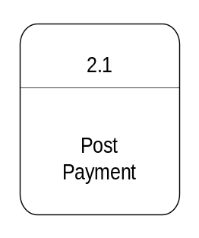

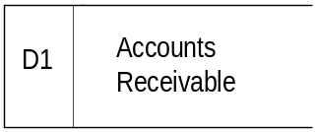

Data Flows
The route that data takes between the external entities, processes and data stores.
It portrays the interface between the other components and is shown with arrows, typically labeled with a short data name, like “Billing details.”
Data Flow

Slide 9
Processes
  Any process that changes the data, producing an output. It might perform computations, or sort data based on logic, or direct the data flow (transformed, stored, or distributed)based on business rules.
  A short label is used to describe the process, such as “Submit payment.”
Law of conservation of data:
  #1: Data stays at rest unless moved by a process.
  #2: Processes cannot consume or create data
    Must have at least 1 input data flow (to avoid miracles)
    Must have at least 1 output data flow (to avoid black holes)
    Should have sufficient inputs to create outputs (to avoid gray holes)
0.
Processes

Slide 10
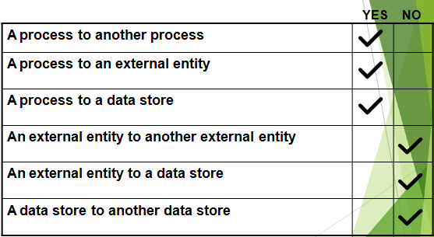
General DFD Rules

Slide 11
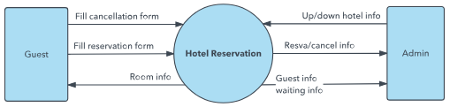
Data flow diagram levels
Level 0 DFDs, also known as context diagrams, are the most basic data flow diagrams. They provide a broad view that is easily digestible but offers little detail. Level 0 data flow diagrams show a single process node and its connections to external entities.

Slide 12
Data flow diagram levels
Level 1 DFDs:
Are still a general overview, but they go into more detail than a context diagram. In a level 1 data flow diagram, the single process node from the context diagram is broken down into sub processes. As these processes are added, the diagram will need additional data flows and data stores to link them together.

Slide 13
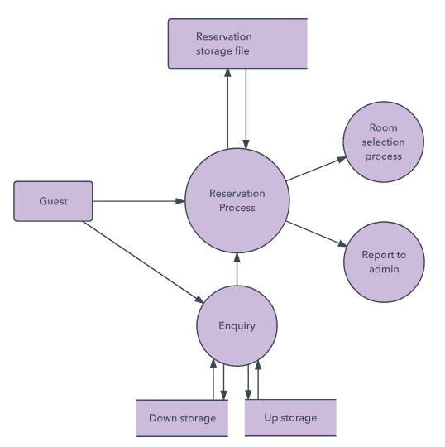
Data flow diagram levels

Slide 14
Data flow diagram levels
Level 2+ DFDs:
Simply break processes down into more detailed sub processes. In theory, DFDs could go beyond level 3, but they rarely do. Level 3 data flow diagrams are detailed enough that it doesn’t usually make sense to break them down further.

Slide 15
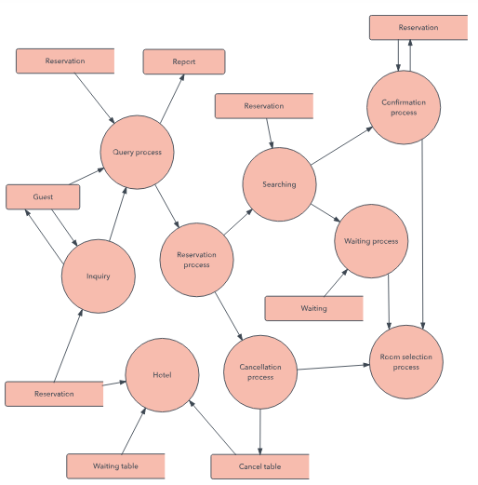
Data flow diagram levels

Slide 16
How to create a data flow diagram
Identify major inputs and outputs in your system
Build a context diagram
Expand the context diagram into a level 1 DFD
Expand to a level 2+ DFD
Confirm the accuracy of your final diagram

Slide 17
Decomposition of DFDs
Functional decomposition
  Act of going from one single system to many component processes
  This is a repetitive procedure allowing us to provide more and more detail as necessary
  The lowest level is called a primitive DFD
Level-N Diagrams
  A DFD that is the result of n nested decompositions of a series of sub processes from a process on a level-0 diagram

Slide 18
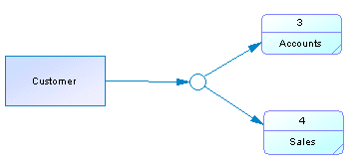
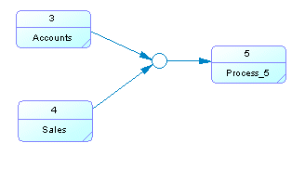
Split and Merge
A split/merge allows you to either splits a flow into several flows so that it can send data to different destinations, or merges flows from different sources into one flow.
Example 1: Shows a split/merge with a single incoming flow and multiple outgoing flows.
Example 2: Shows a split/merge with multiple incoming and a single outgoing flow.

Slide 19
DFD Rules—Balancing DFDs
The conserving inputs to and outputs from a process when decomposing a DFD at the next level of decomposition is called DFD balancing.
Example: Food Restaurant
  Inputs: One
    customer order
  Outputs: Three
    Customer receipt
    Food order
    Management reports

Slide 20
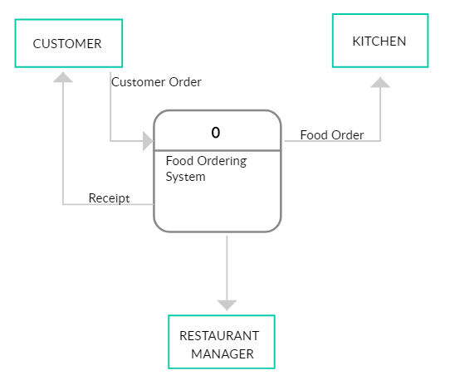
DFD Rules—Balancing DFDs

Slide 21
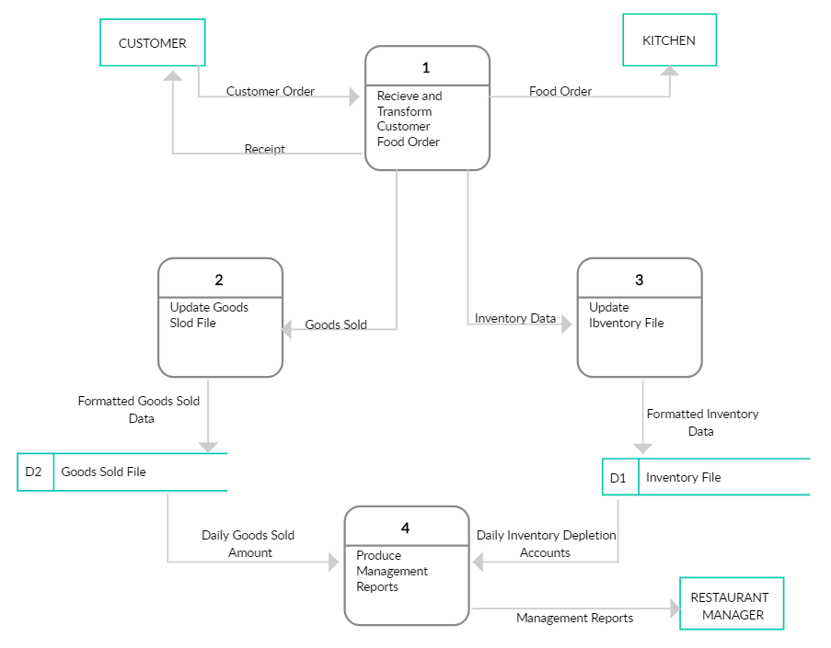
DFD Rules—Balancing DFDs

Slide 22
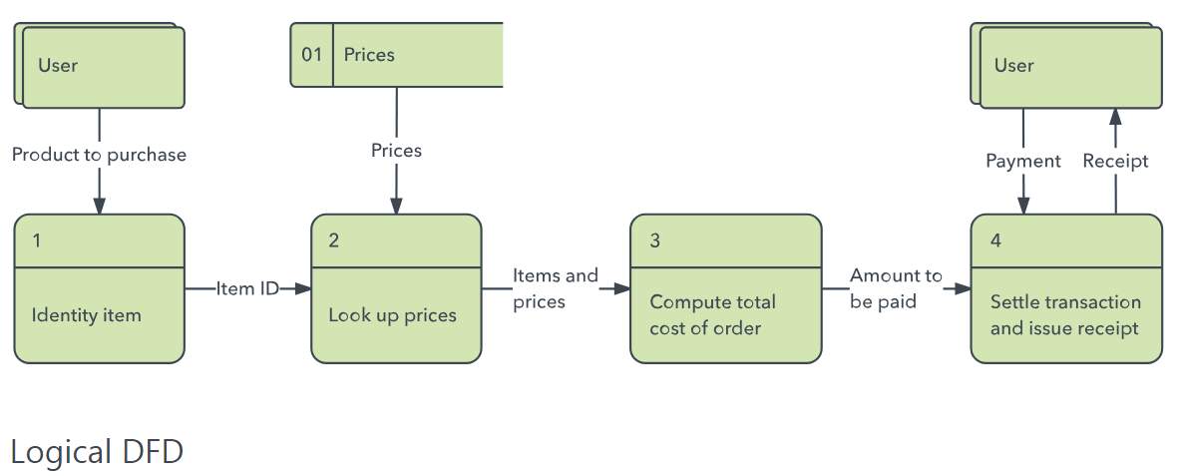
Types of DFDs
Logical DFD:
A logical DFD focuses on the business and business activities.
The logical diagram provides “what” the flow of information for a process.

Slide 23
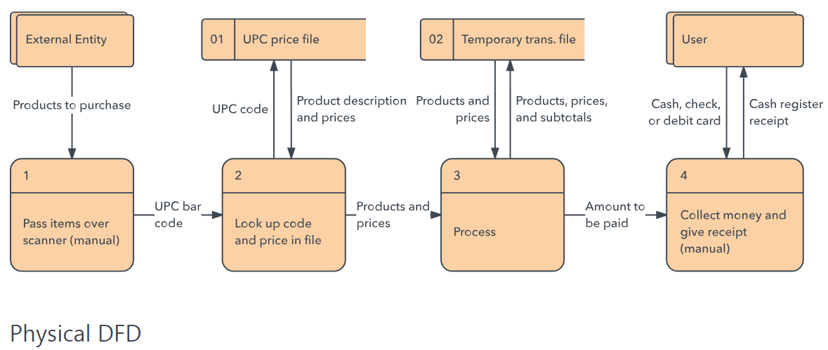
Types of DFDs
Physical DFD:
A physical DFD looks at how a system is implemented.
The physical diagram provides “how” the flow of information for a process.

